Slide 1
A large-scale benchmarking of cell type deconvolution methods
Chichau Miao, Anna Vathrakokili Pournara, Irene Papatheodorou

Slide 2
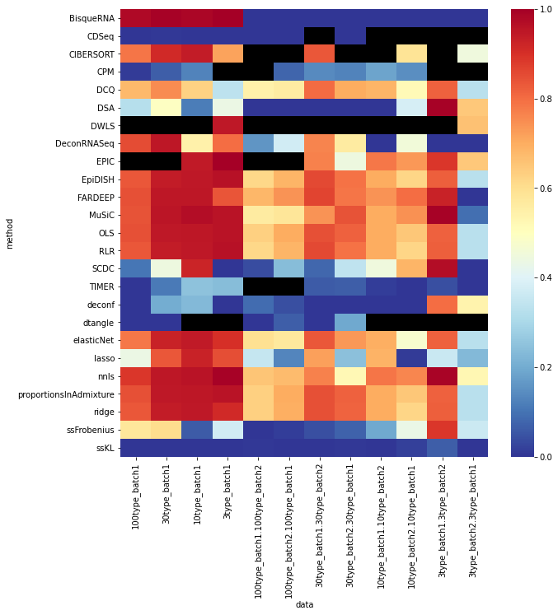

Slide 3
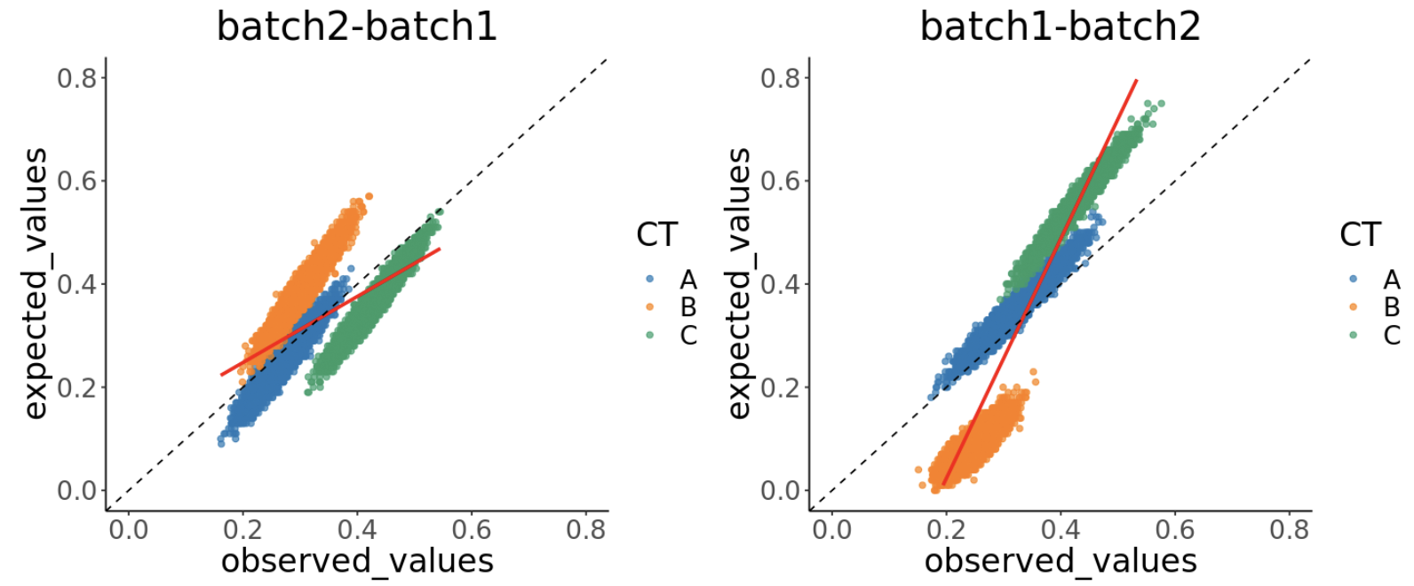
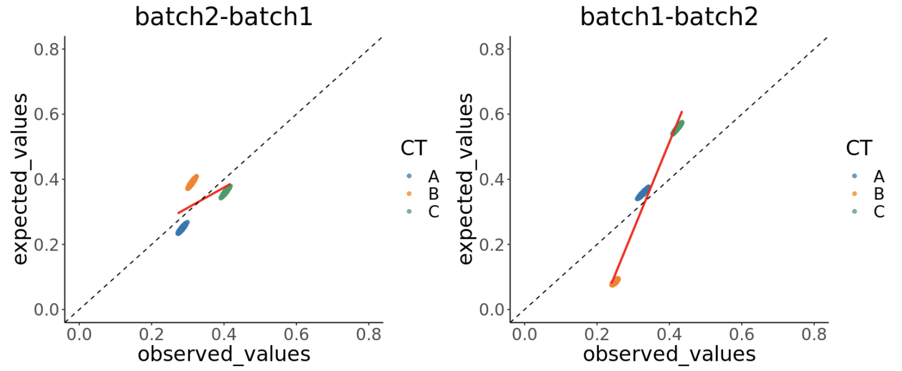
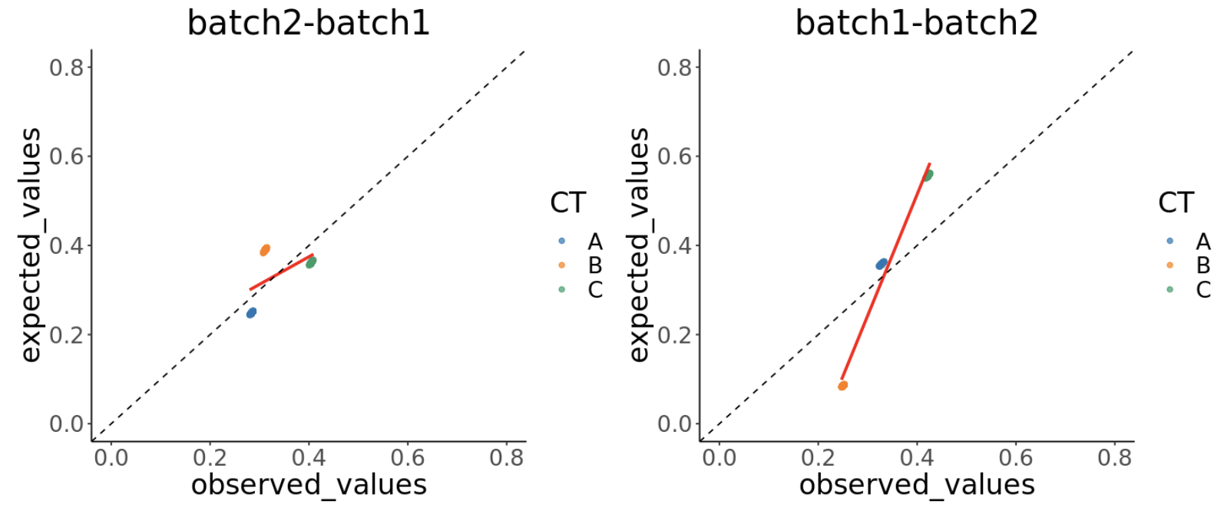
3 simulated cell types, nnls

Slide 4
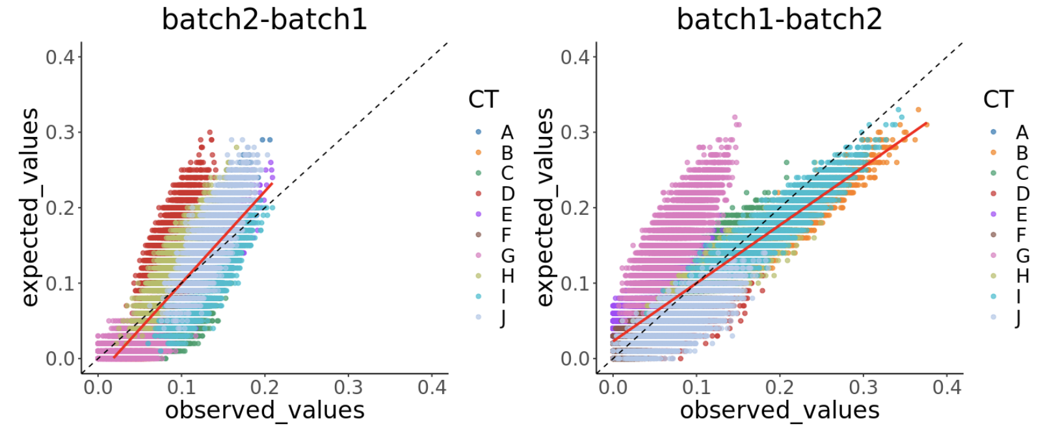
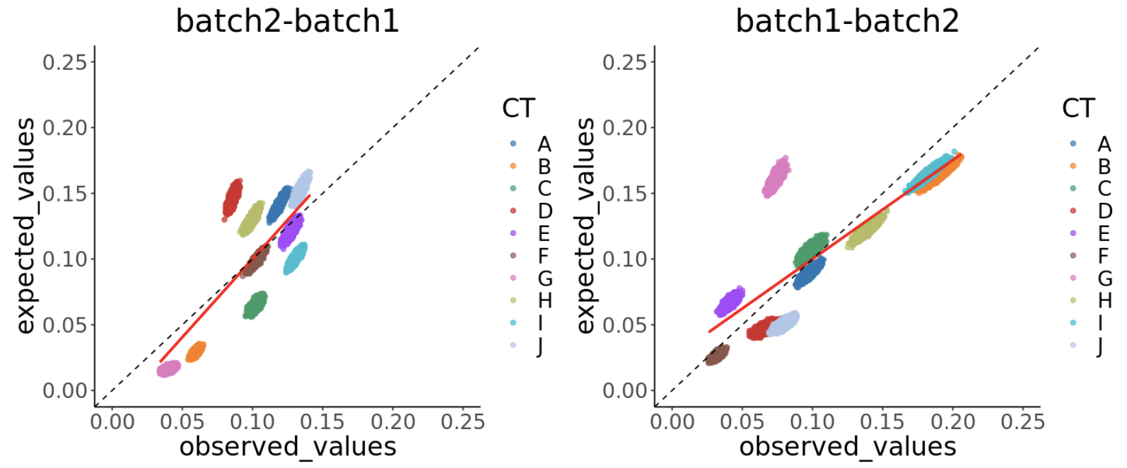
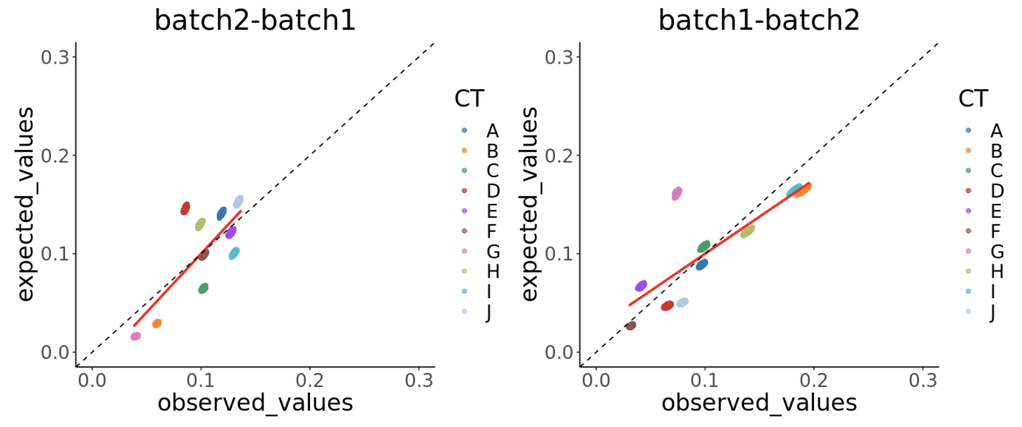
10 simulated cell types, nnls

Slide 5
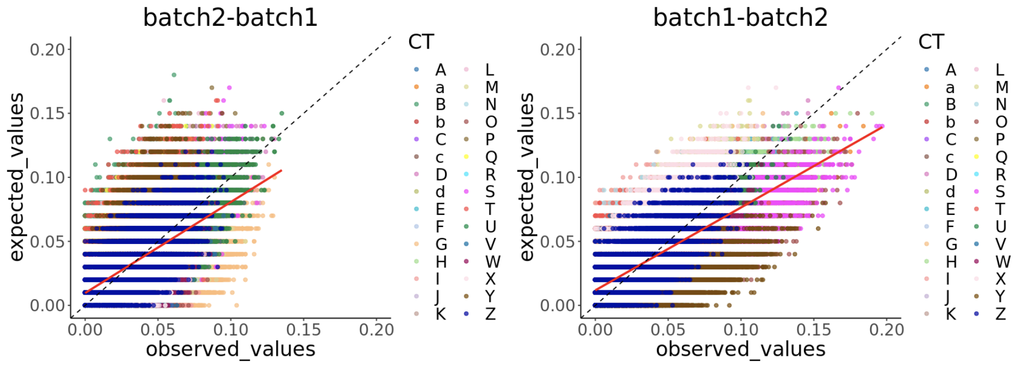
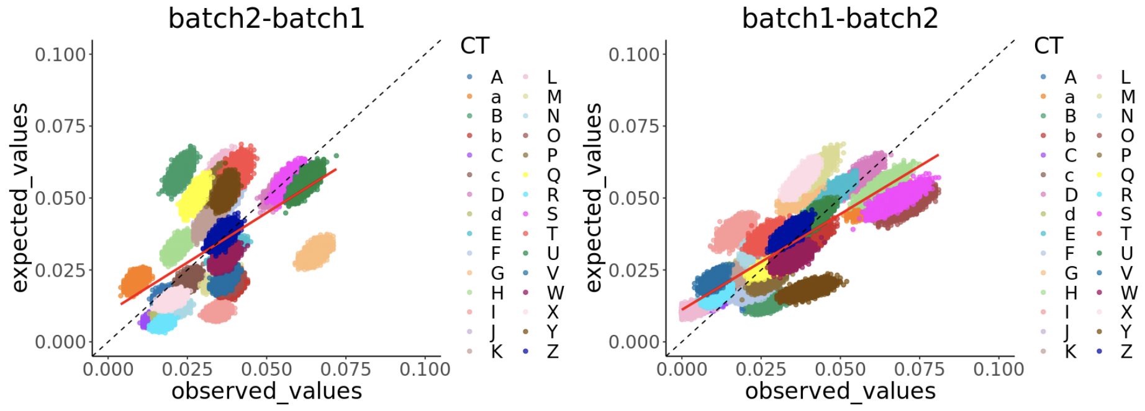
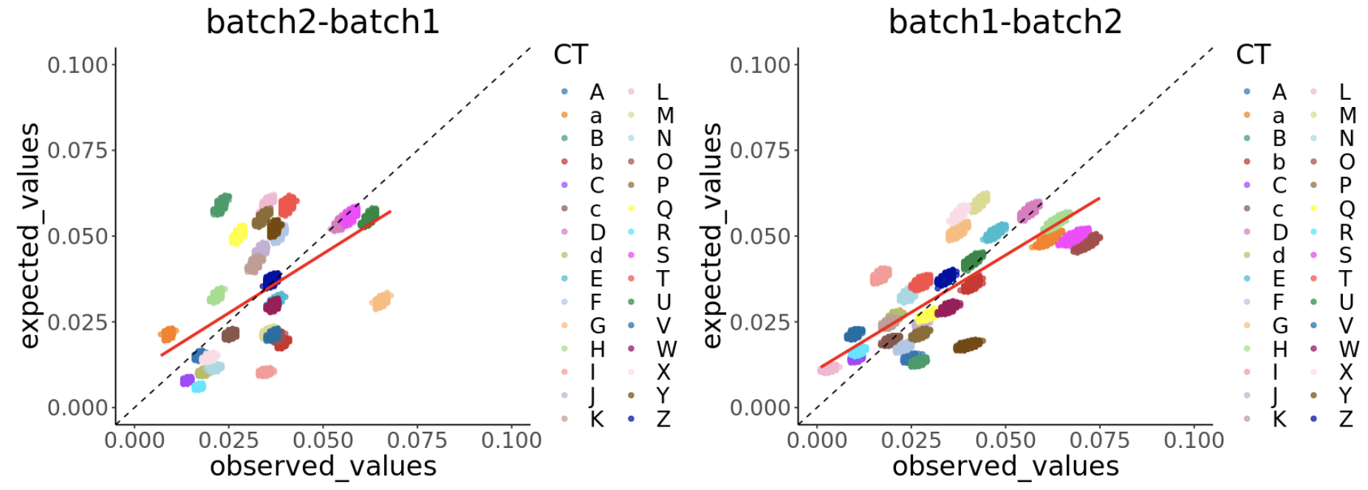
30 simulated cell types, nnls

Slide 6
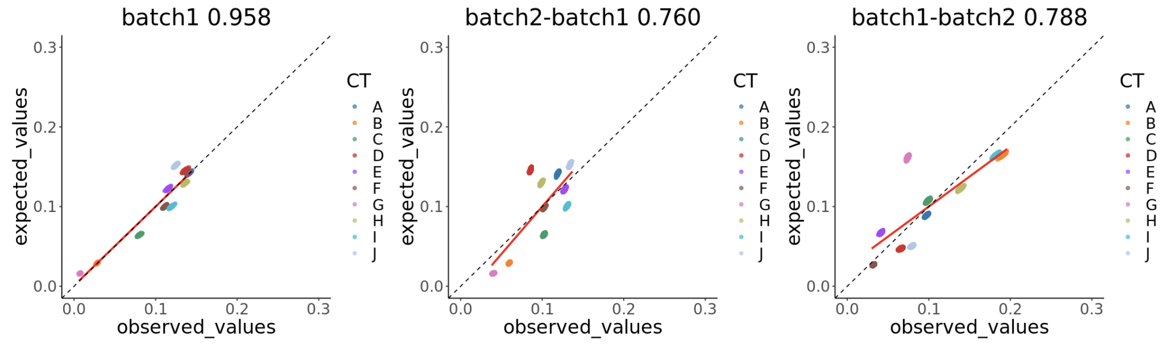
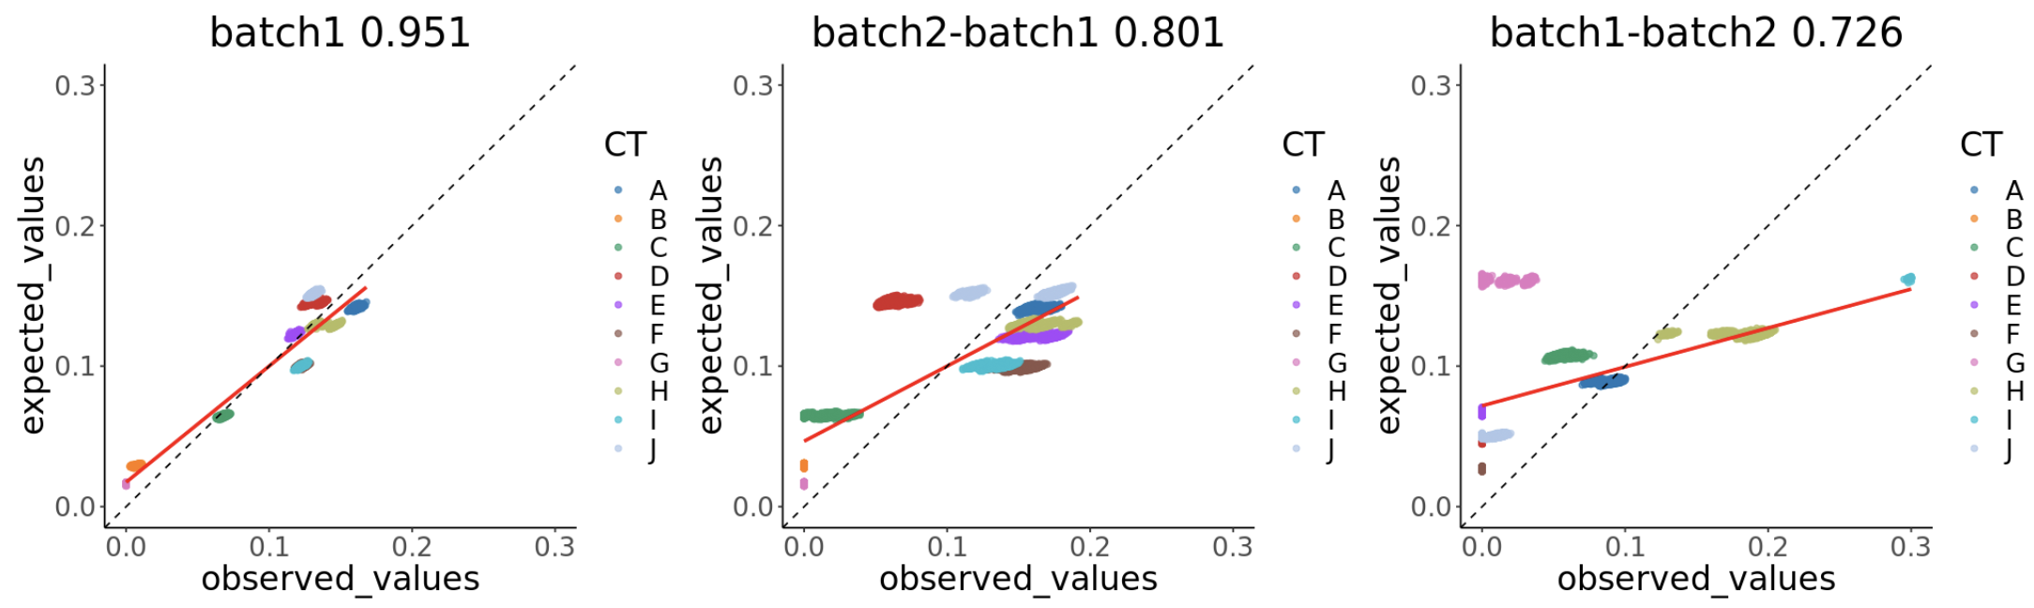
nnls
FARDEEP

Slide 7
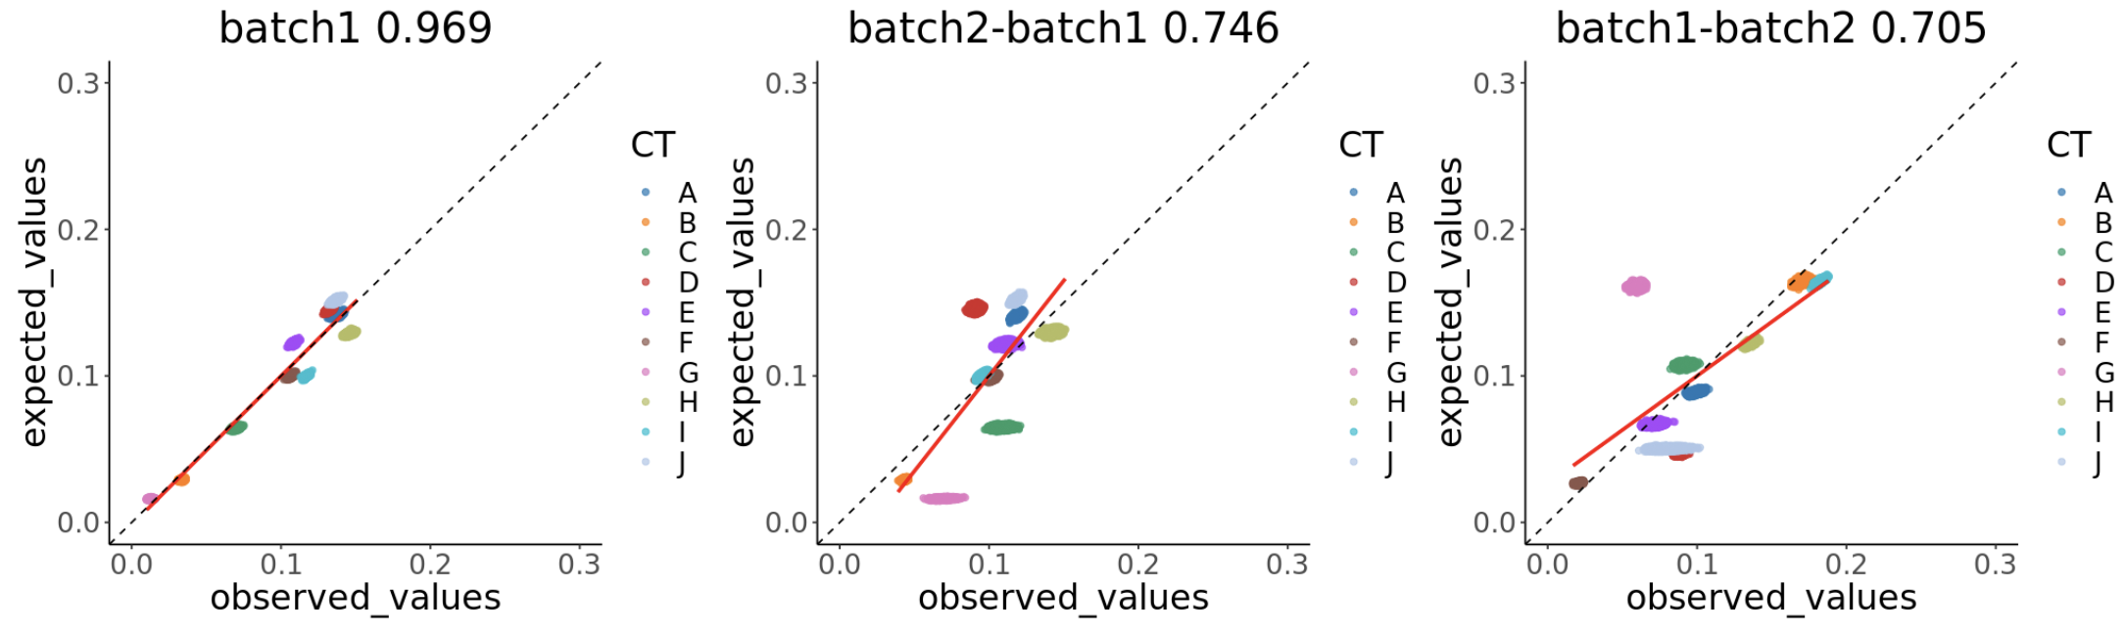
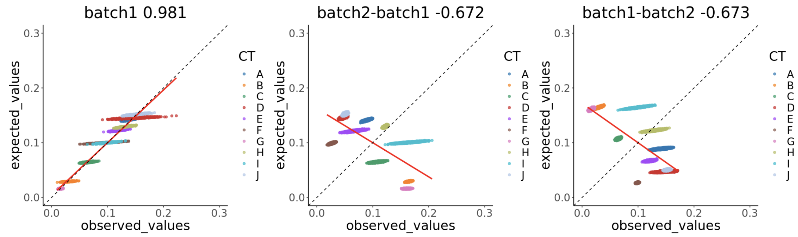
MuSiC
BisqueRNA

Slide 8
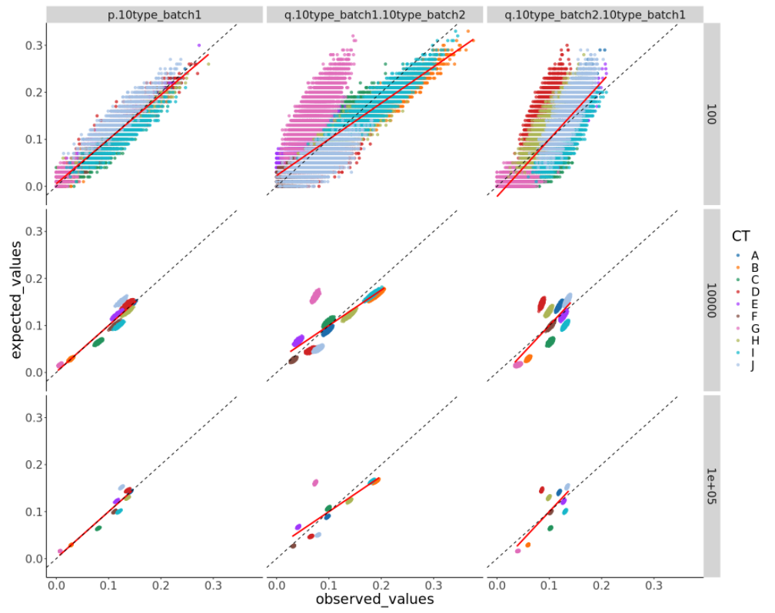
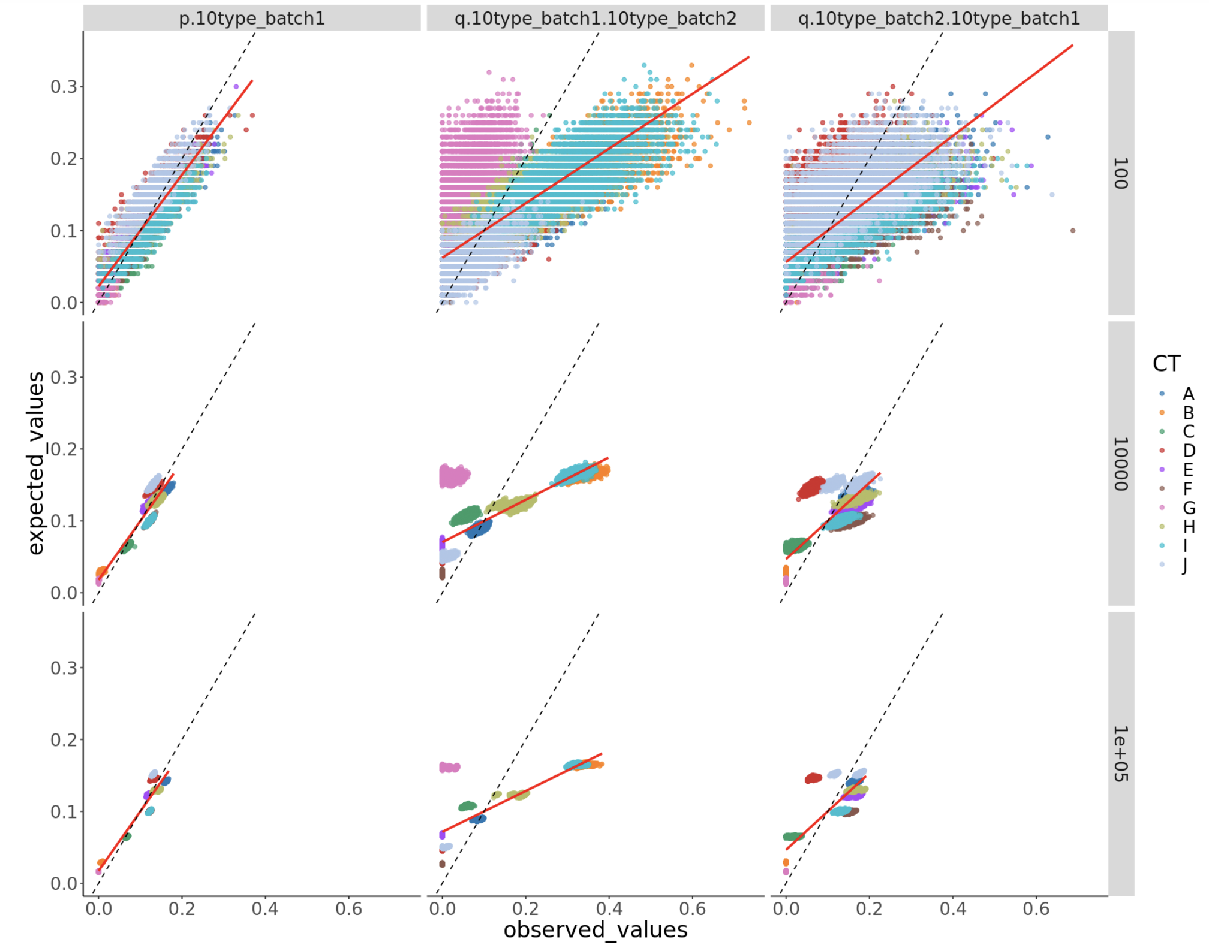
nnls
FARDEEP

Slide 9
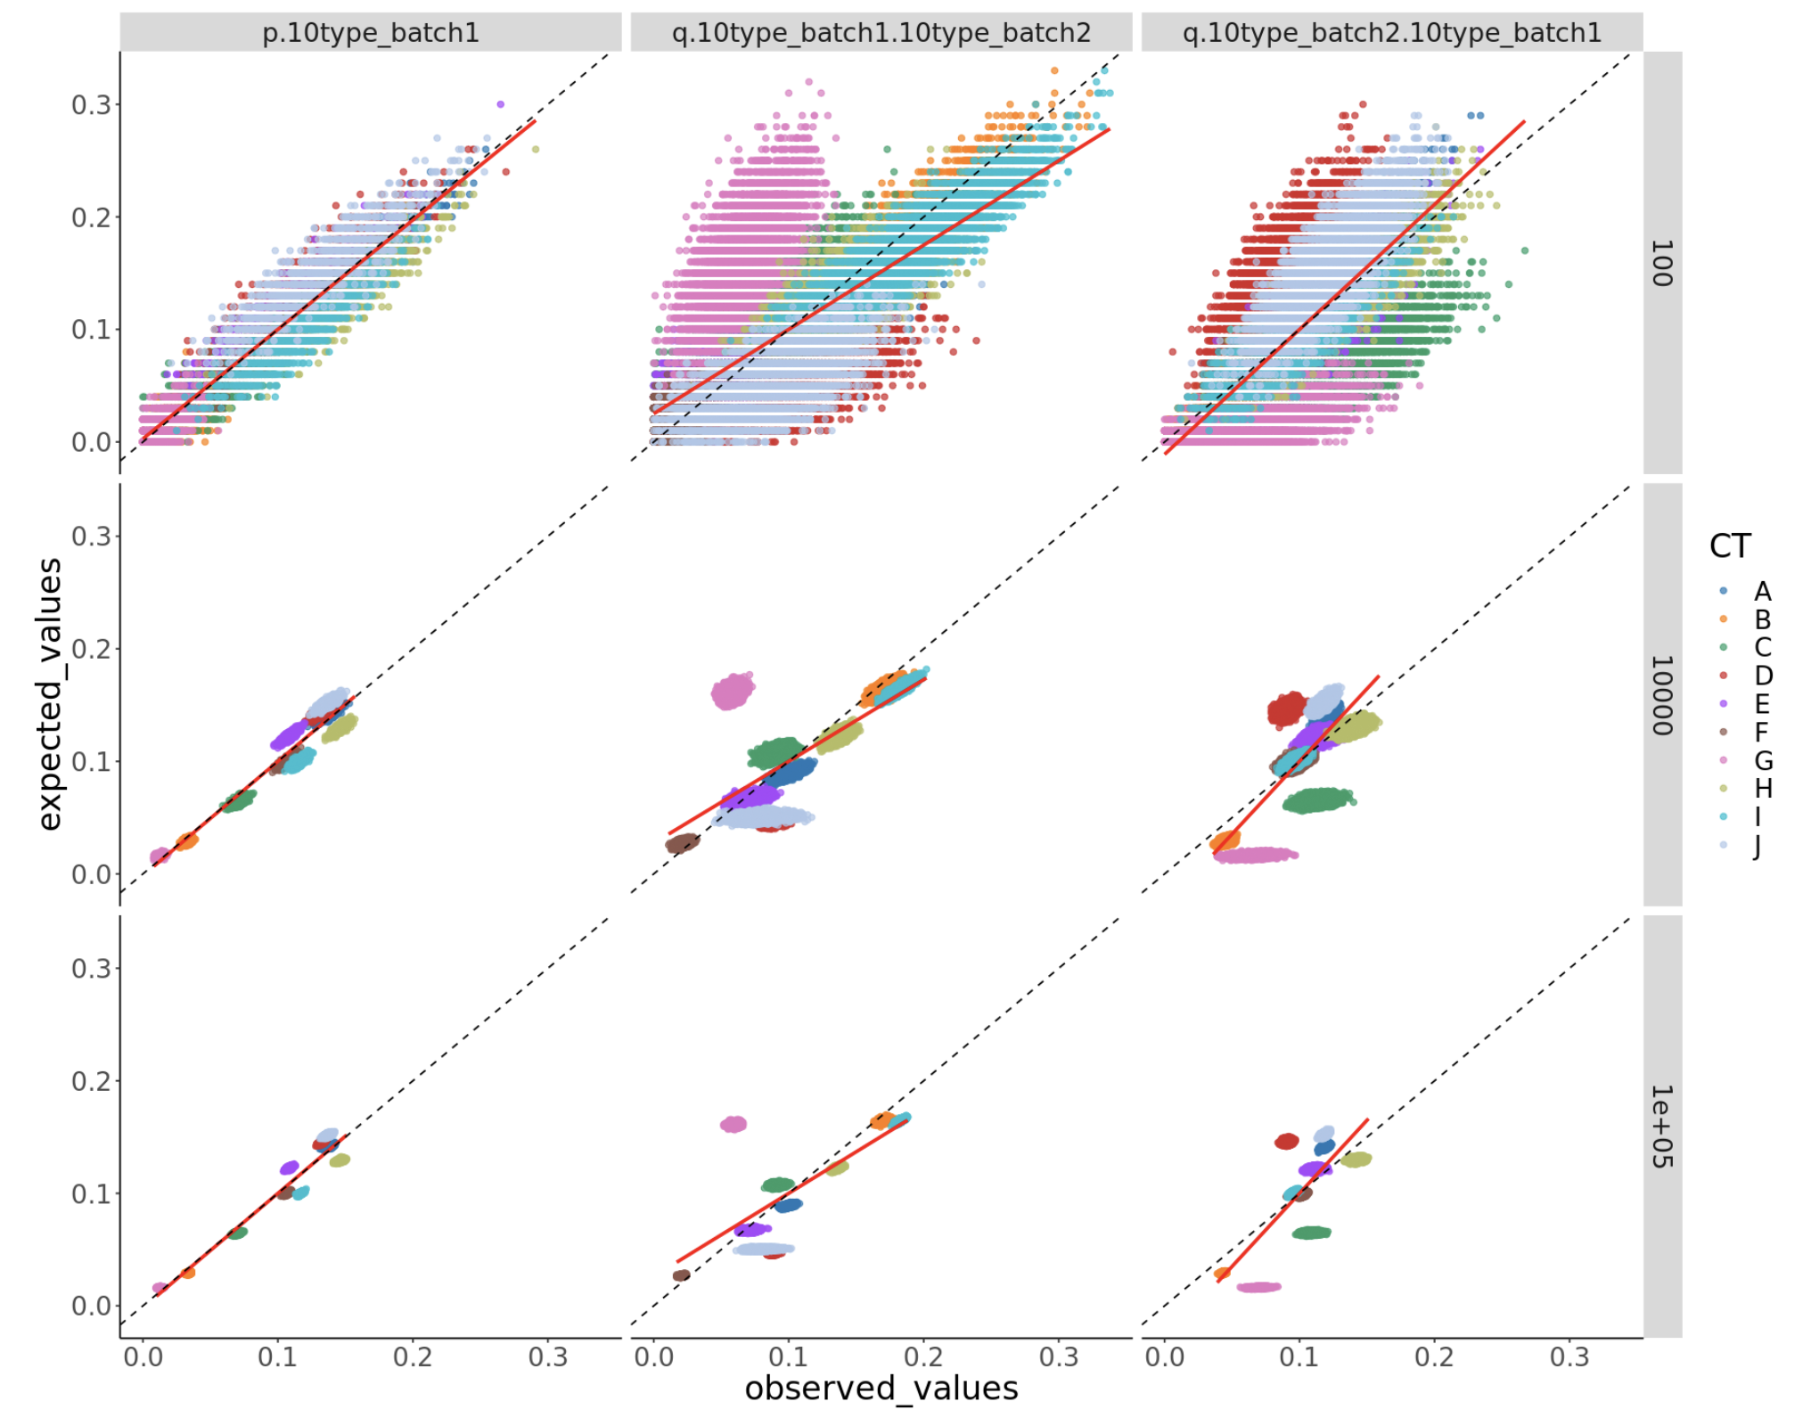
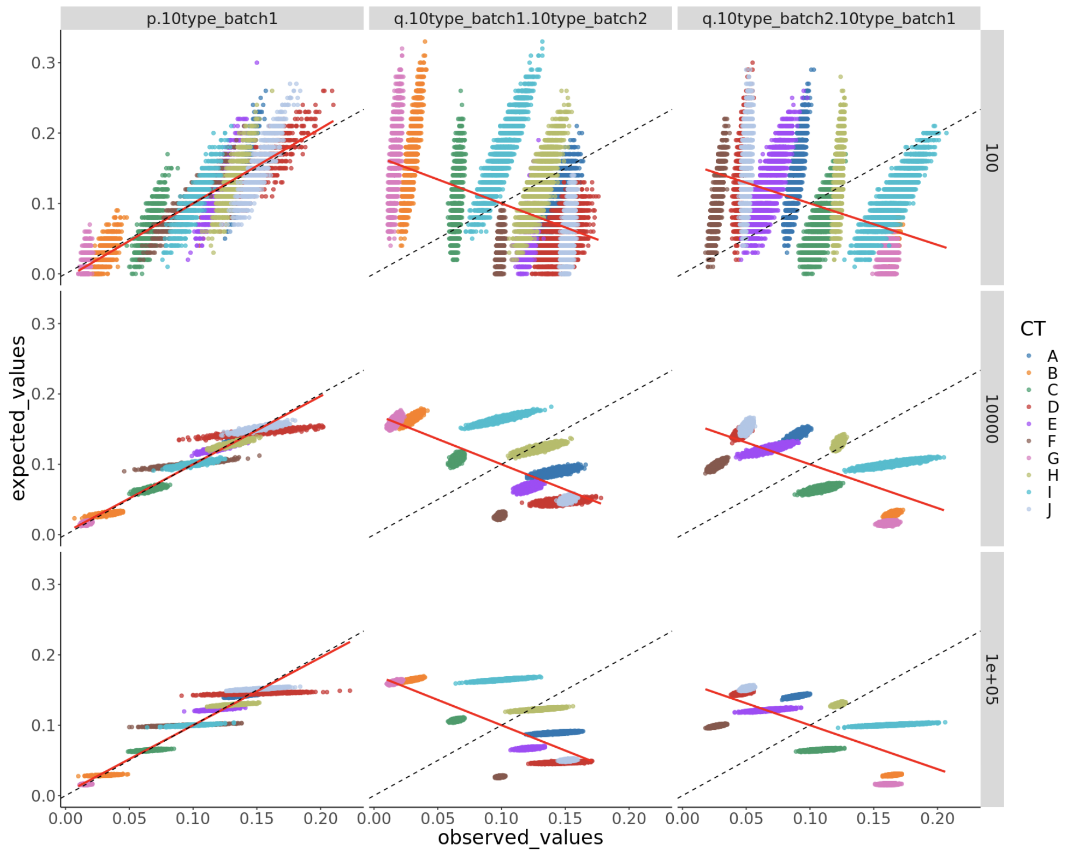
MuSiC
BisqueRNA

Slide 10
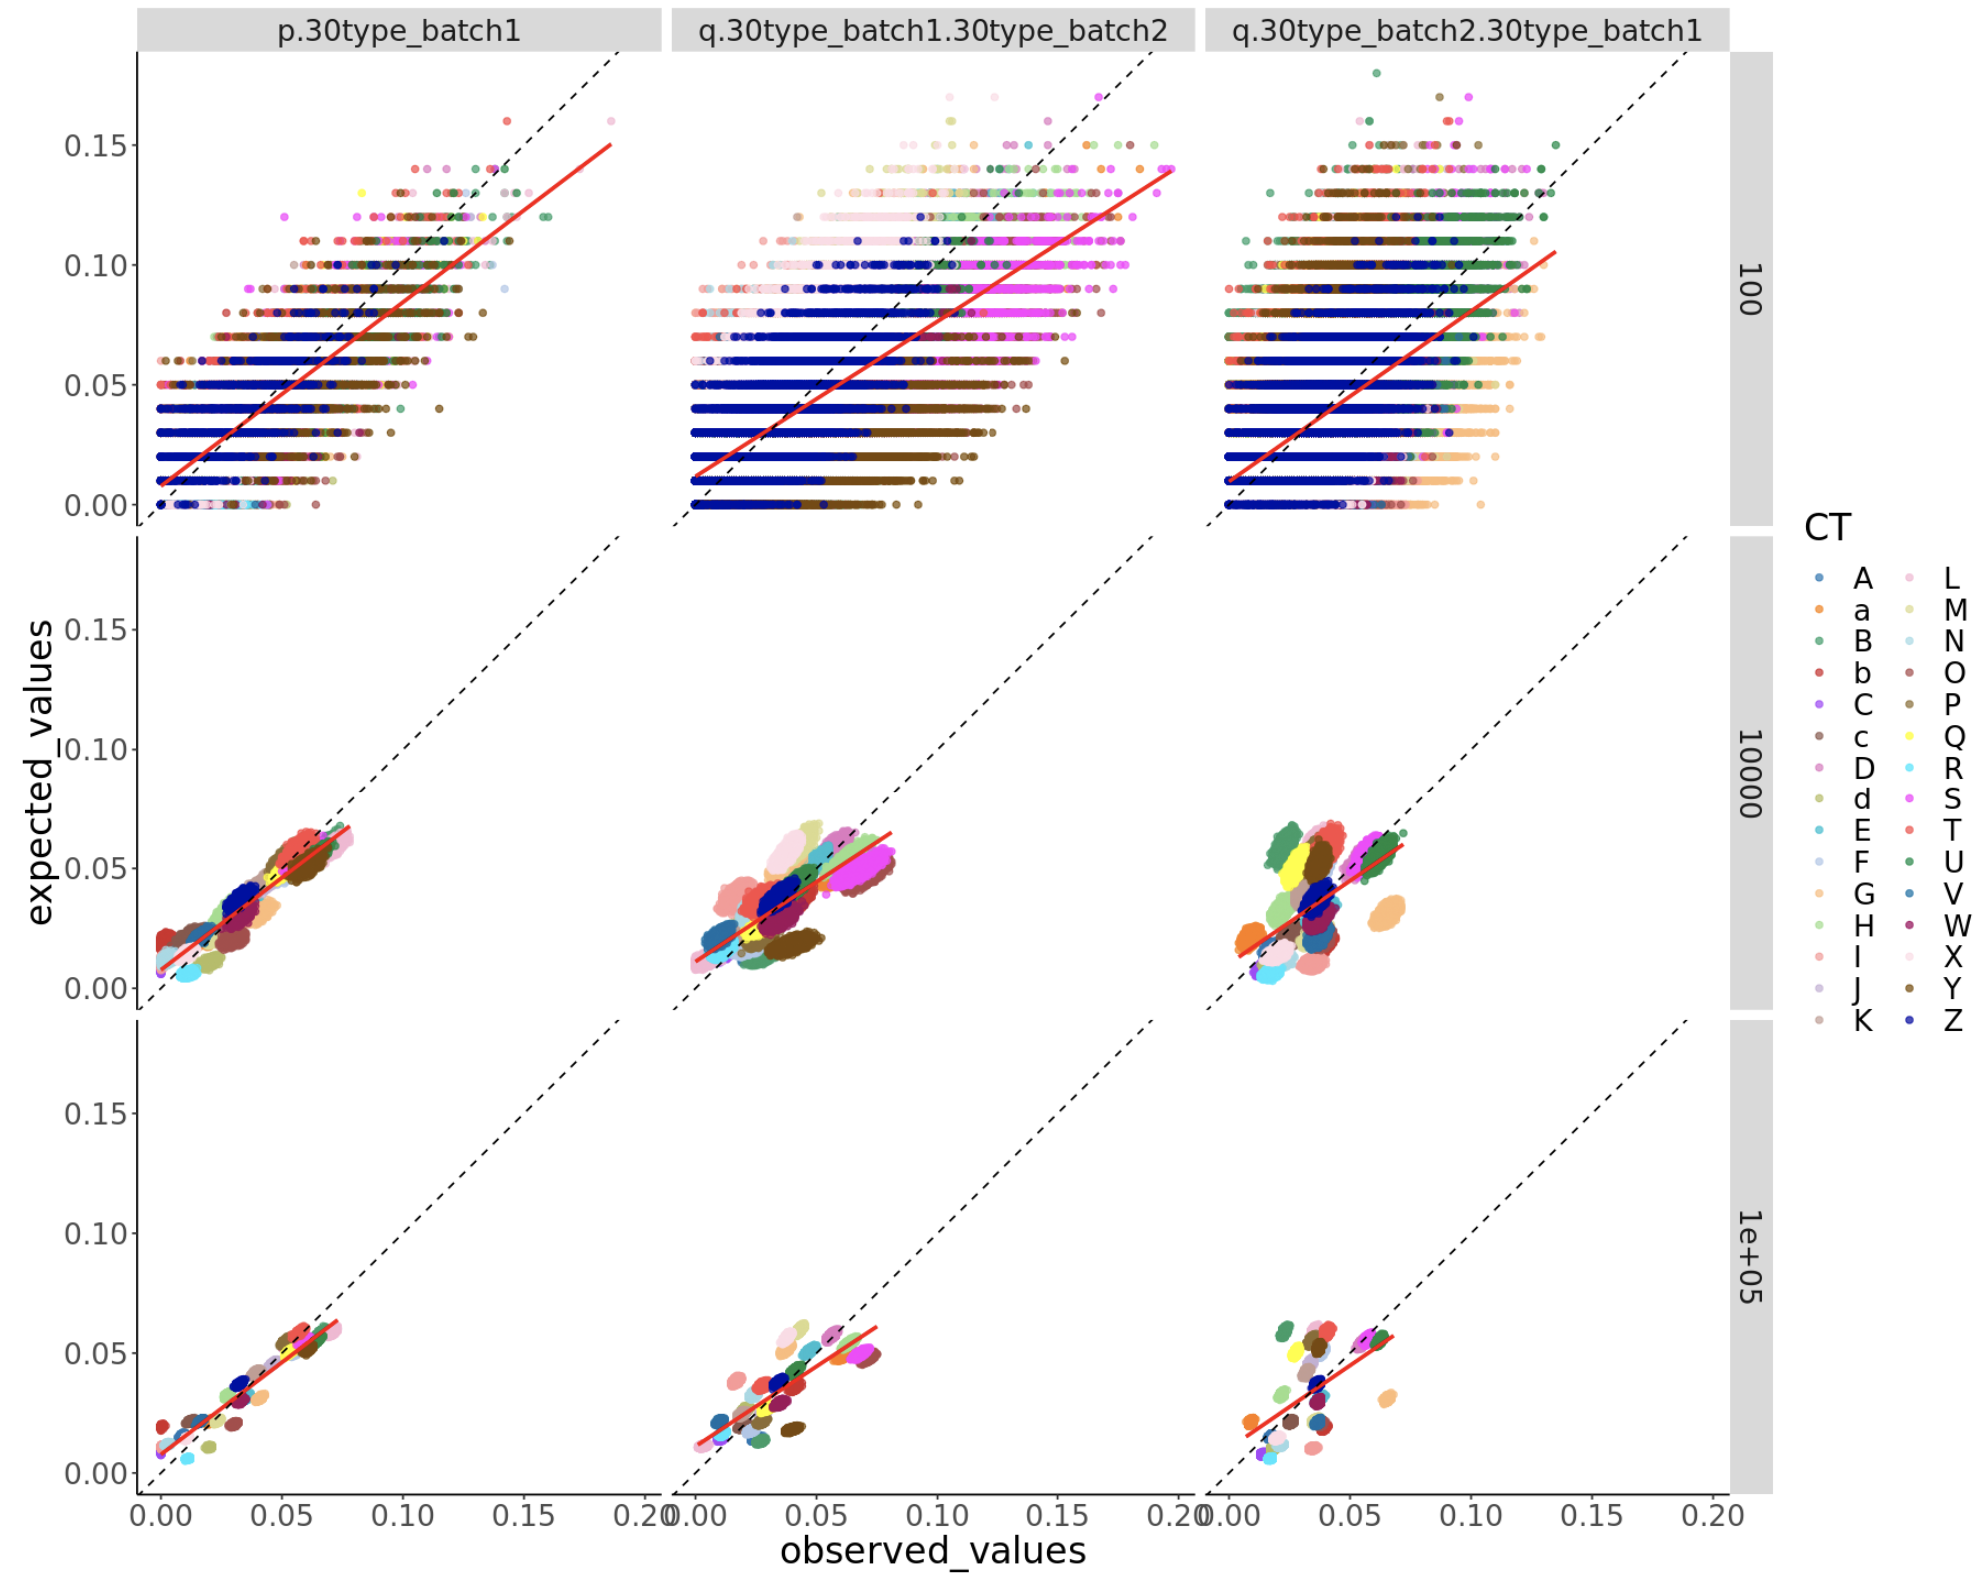
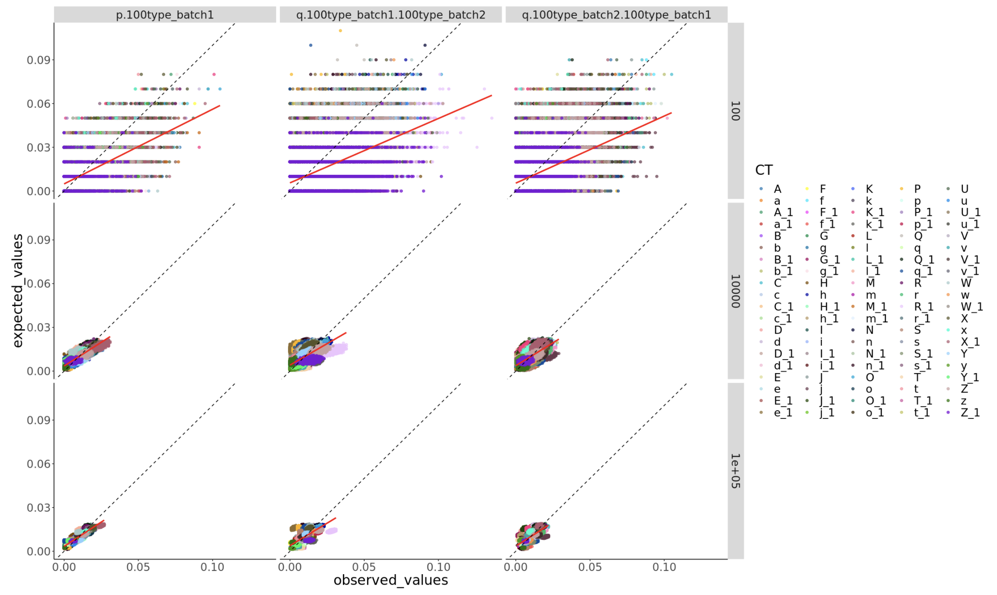
30 cell types
100 cell types

Slide 11
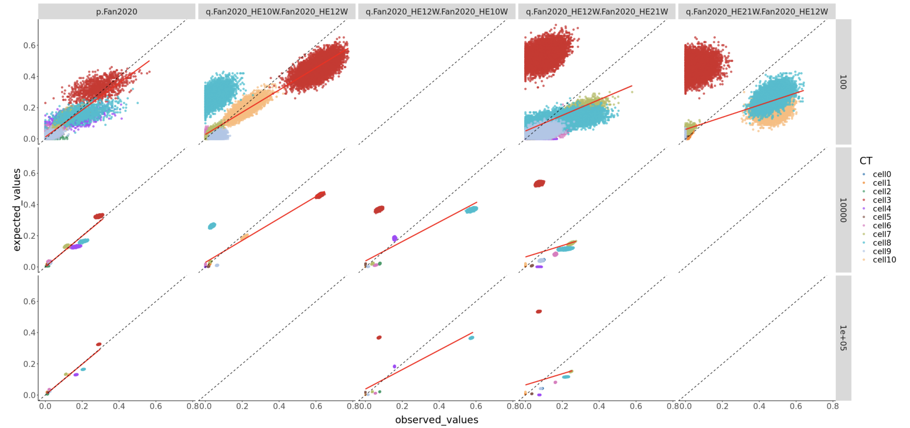
Real example

Slide 12
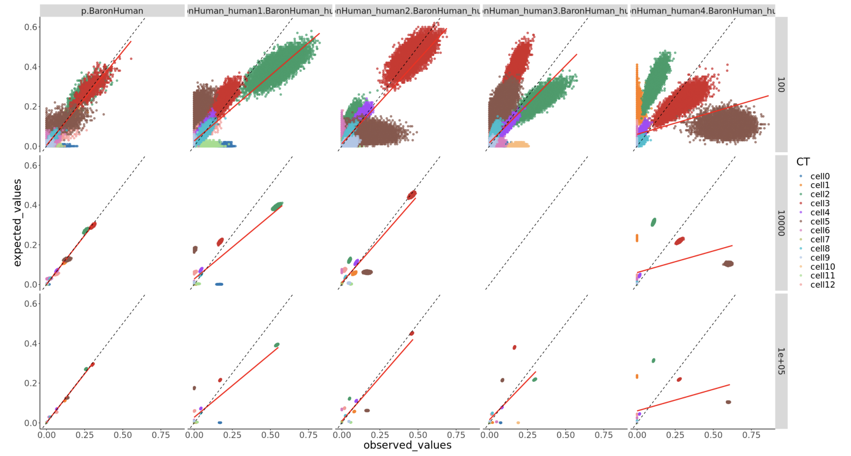
Cross batch

Slide 13
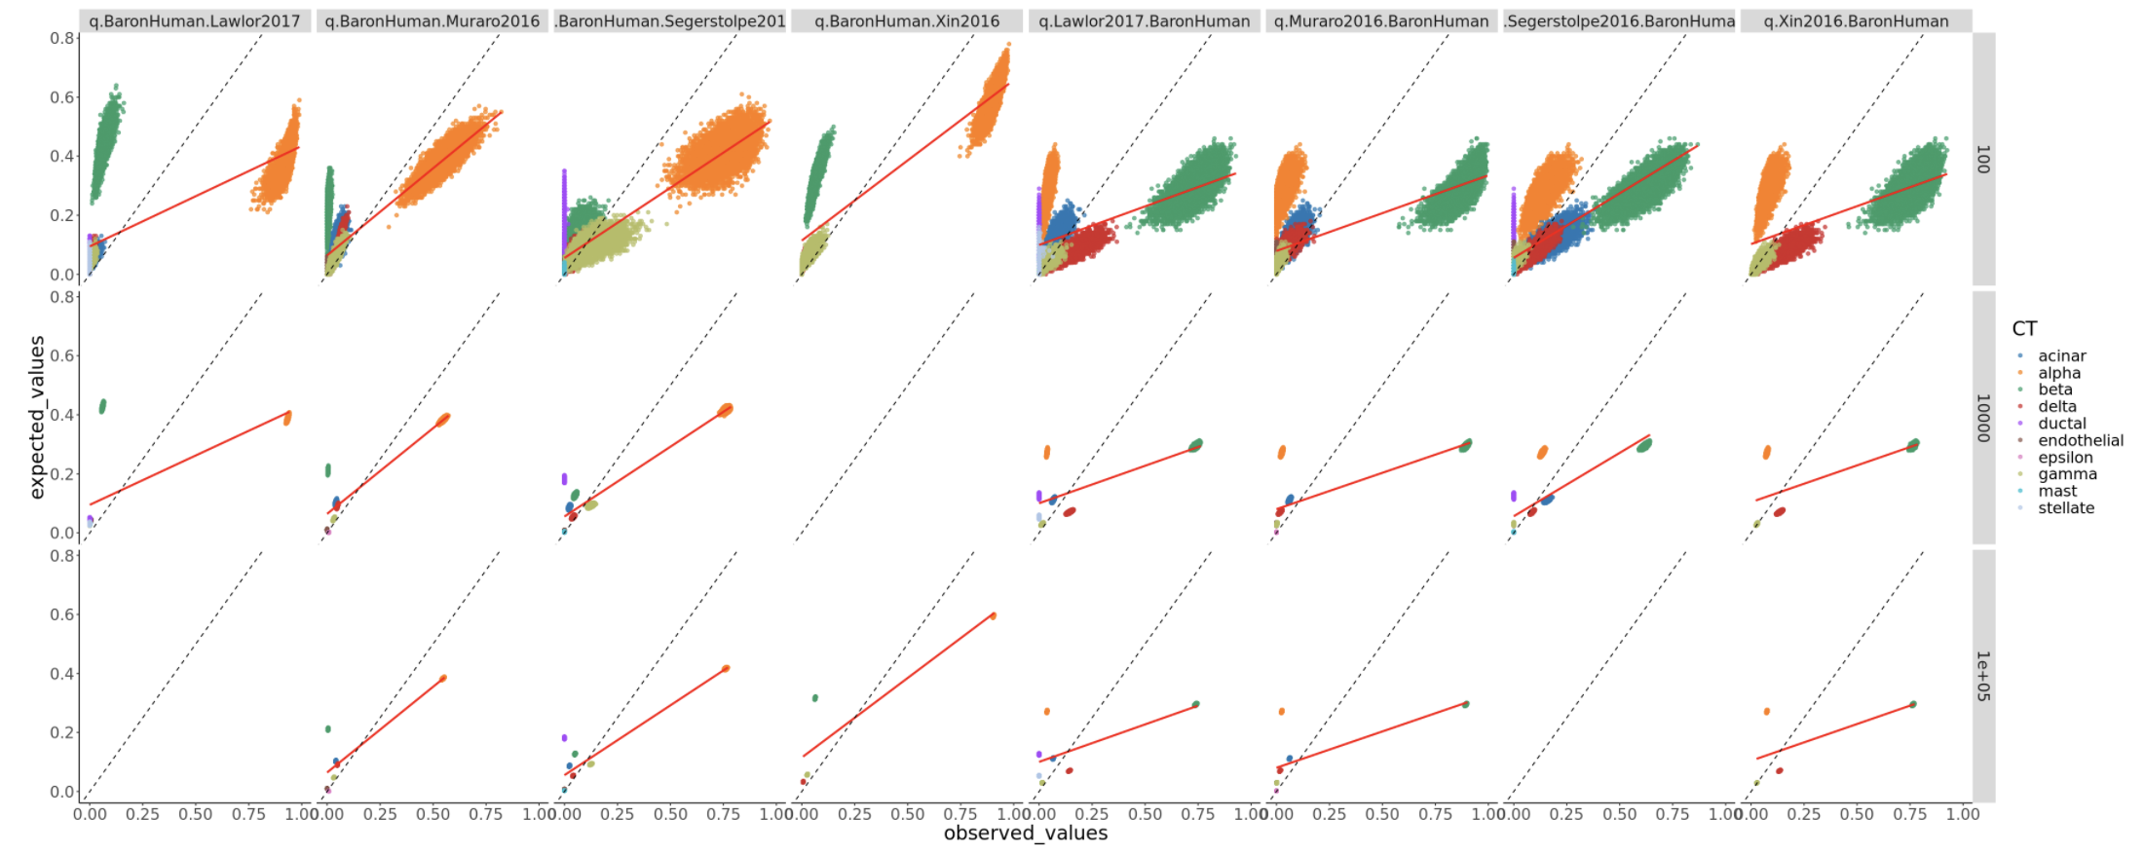
Cross study

Slide 14
Old

Slide 15
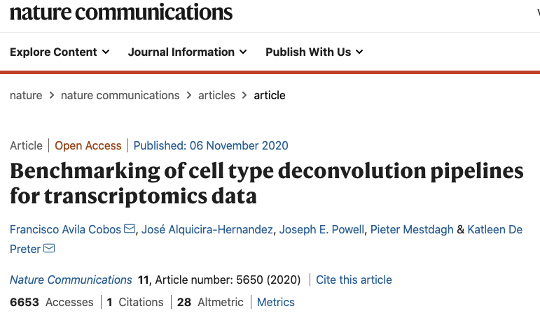
Background
Gap:
Only technical benchmarking
No real scenario analysis
Not significant in interpreting biology problems

Slide 16
Objectives
Understand the performance of deconvolution methods in dealing with bulk RNA-seq data using single-cell RNA-seq as reference;
How to deconvolve disease bulk with healthy single cell data?
How to capture the transcriptomic signal change in the disease samples?
Give suggestions for deconvolution methods to be applied in the pipeline.

Slide 17
Experimental design
 | Bulk | Reference
1: decide the parameters | pseudobulk made from reference | scRNA-seq
2: realistic benchmarking | pseudobulk made from another reference (batch effect) | scRNA-seq
3: benchmarking & potential application | Bulk RNA-seq of the same tissue | scRNA-seq
4: benchmarking & potential application | Bulk RNA-seq of the same tissue | 2 scRNA-seq

Slide 18
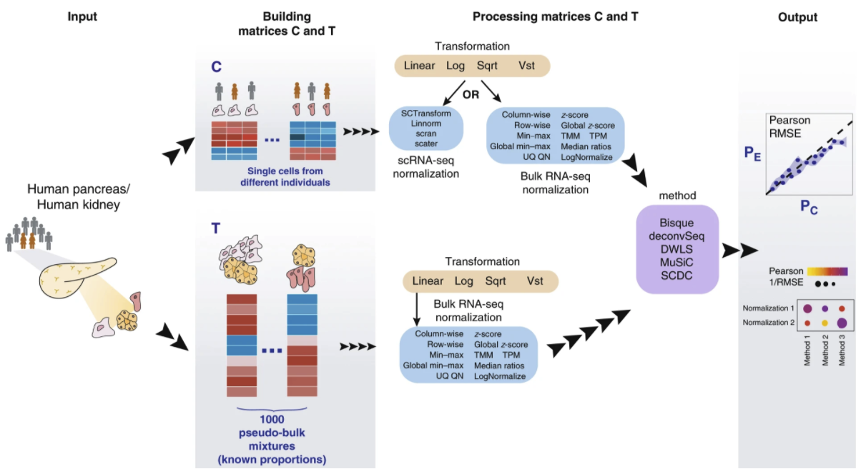
1. Self-reference (easy case)
Anndata
downsample
ExpressionSet

Slide 19
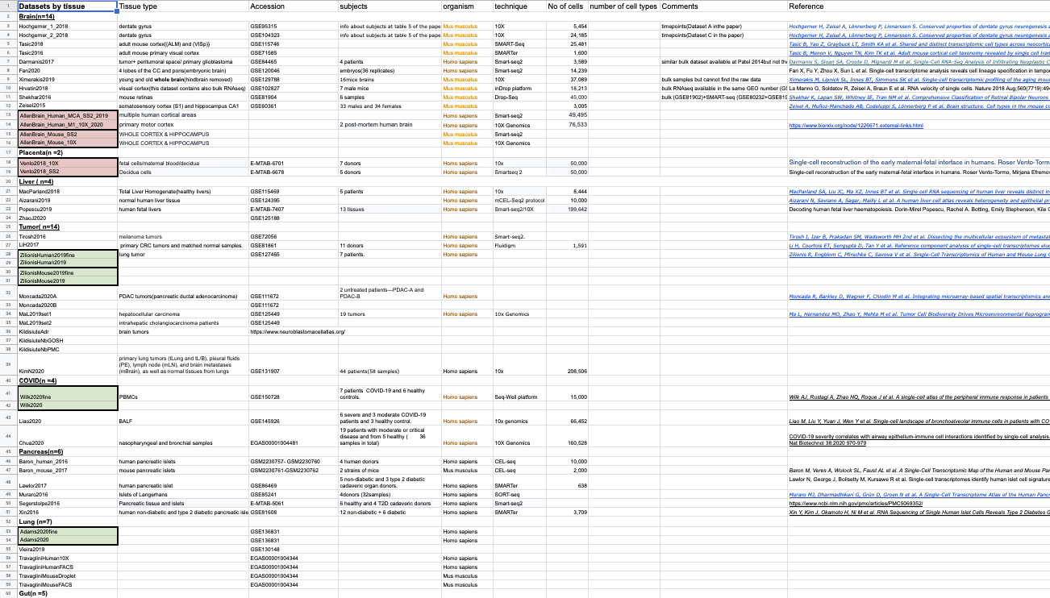
Datasets

Slide 20
Datasets
>57 datasets, covering brain (14), placenta(2), liver(4), tumor(14), COVID-19(4), Pancreas(6), Lung(7),Gut(5), Muscle(1)
10X and Smart-seq2 (SS2) in the same study
10X and SS2 for the same tissue from different studies
10X and bulk in the same study
10X and bulk for the same tissue from different studies
Coarse and fine cell type annotations (4 datasets)

Slide 21
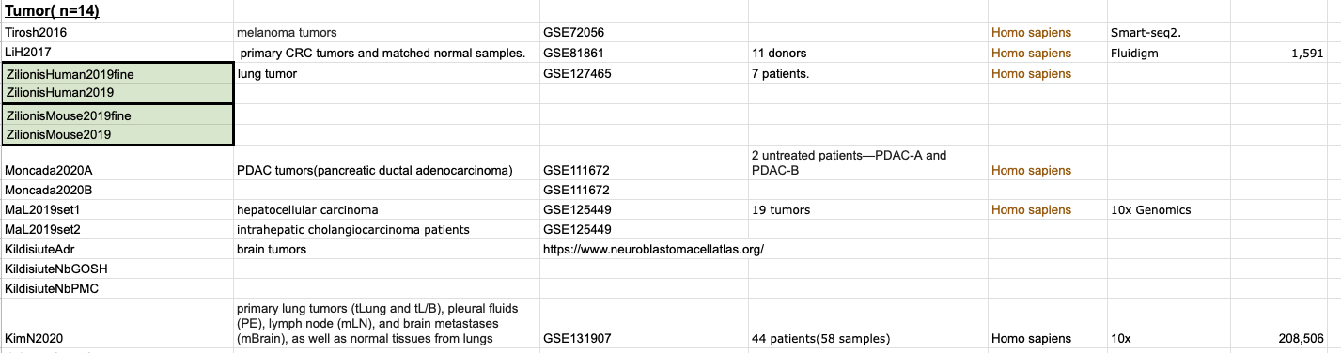
Tumor datasets

Slide 22
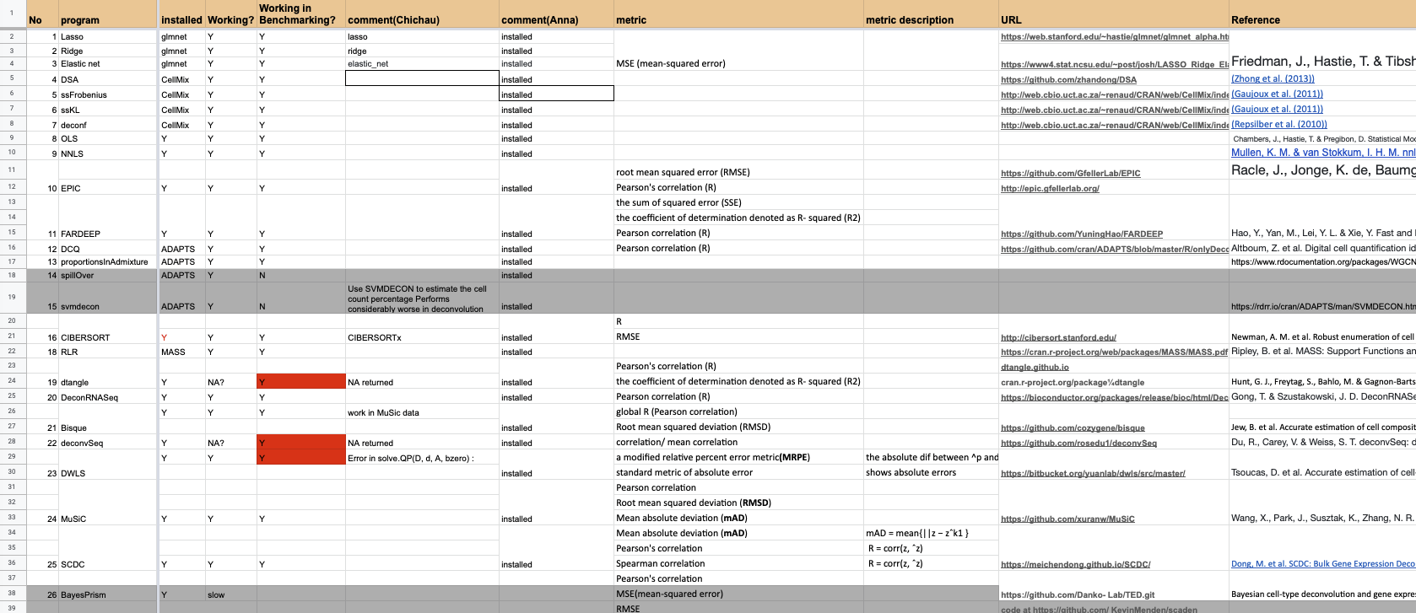
Deconvolution methods

Slide 23
Installation
Conda based dependencies
Independent programs
Bioconda based R packages
Cran based R packages
Github based packages

Slide 24
Preliminary tests
Bseqsc can take >9 days to compute

Slide 25
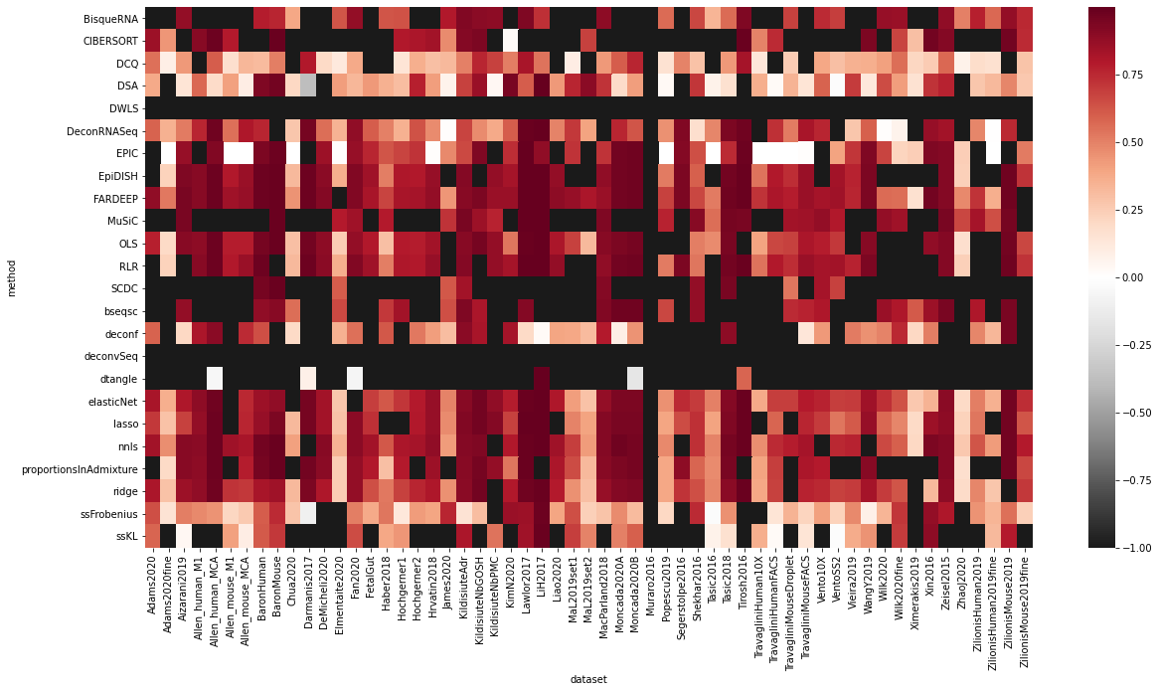
Preliminary results (Pearson correlation)

Slide 26
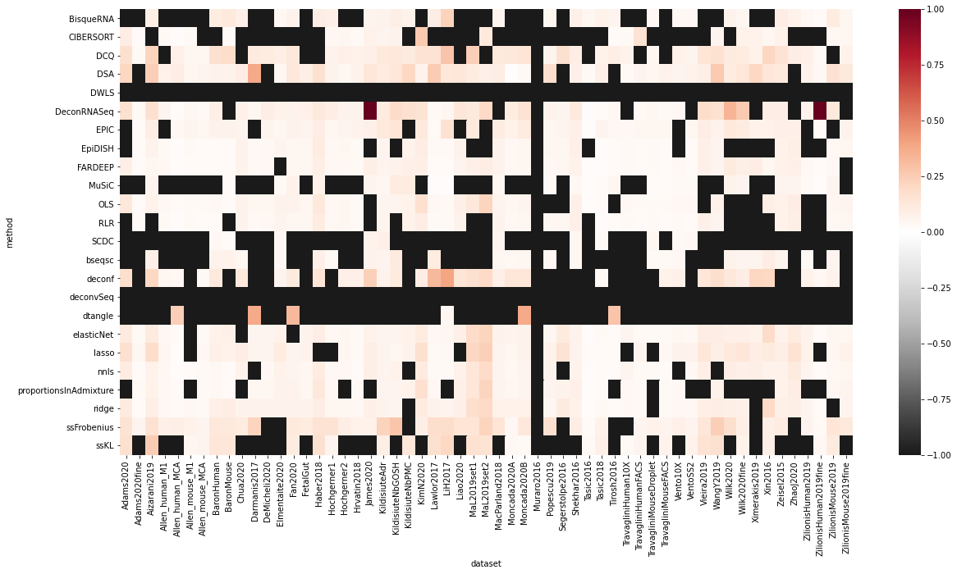
Preliminary results (RMSE)

Slide 27
Next Steps:
Deconvolution between datasets (use different datasets of the same tissue type)
Deconvolution between different techniques (10X vs SS2)
Deconvolution of bulk samples using scRNA-seq in the same study
Test the speed

Slide 28
Data Simulation

Slide 29
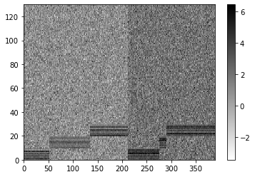
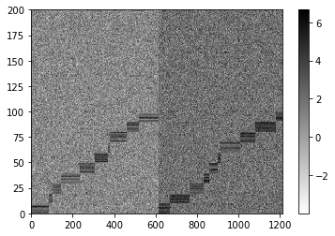
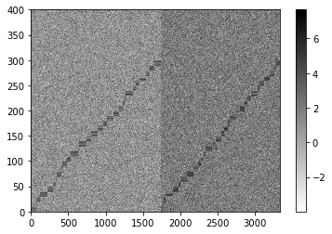
3, 10, 30 cell types

Slide 30
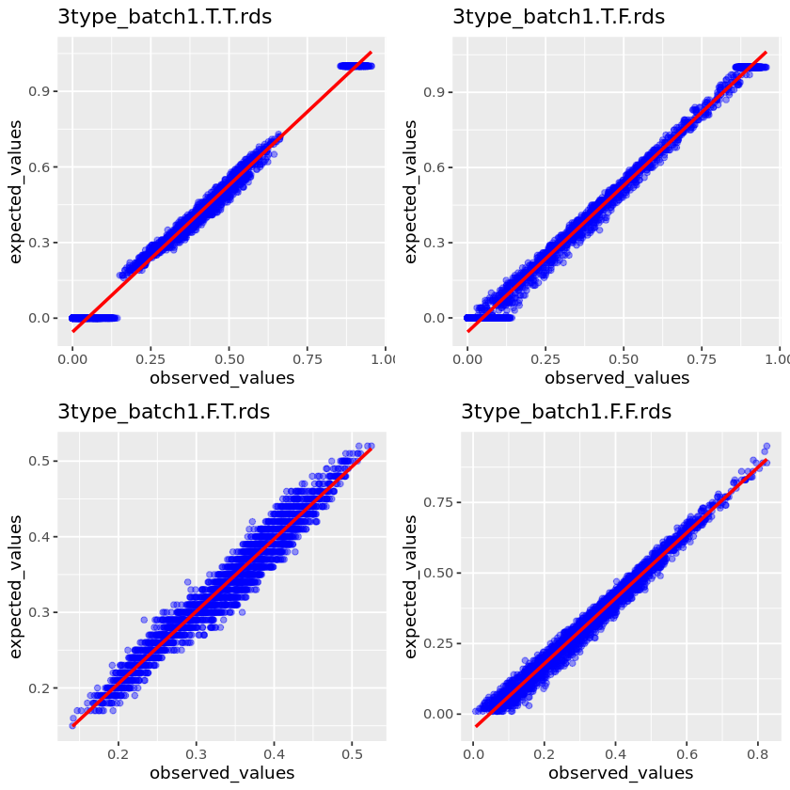
3 cell type, 100 pseudobulk | Prop Sampling | Random sampling
Sample CT
All CT

Slide 31
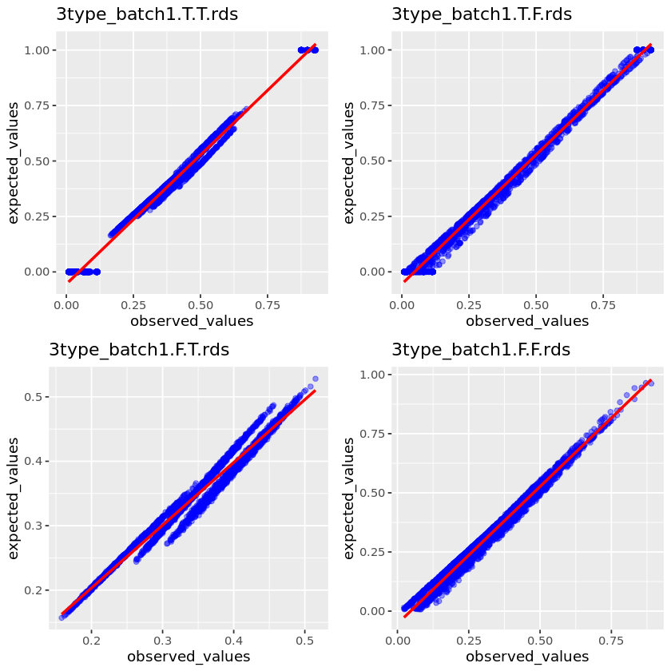
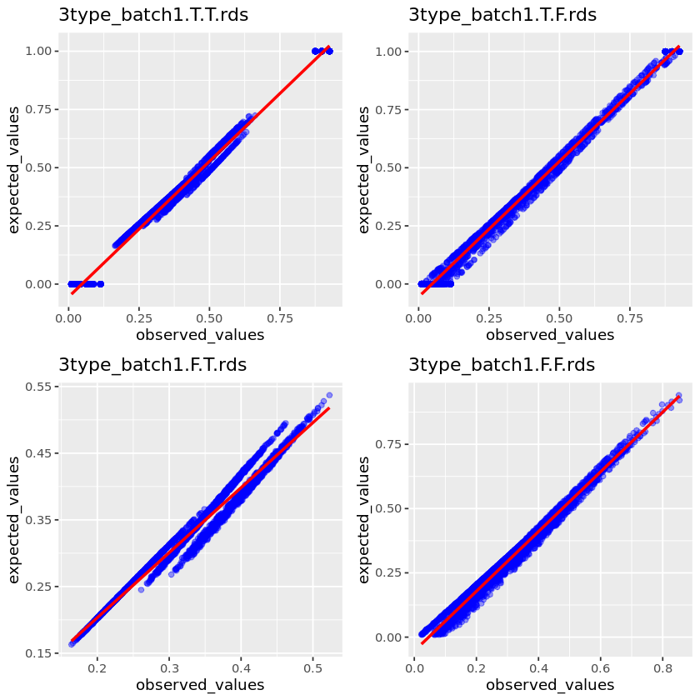
10K pseudobulk
1M pseudobulk

Slide 32
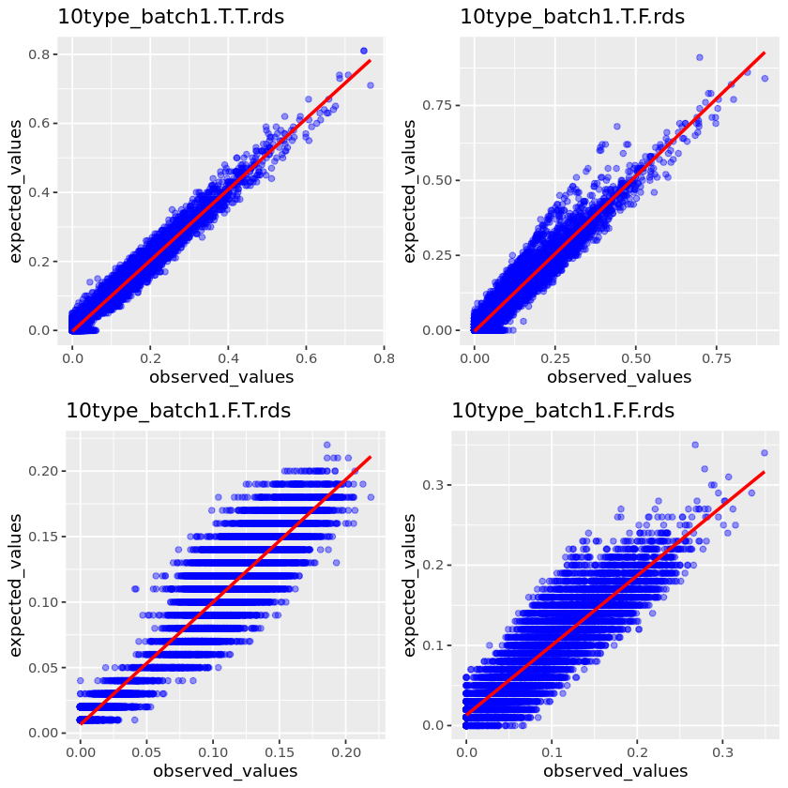
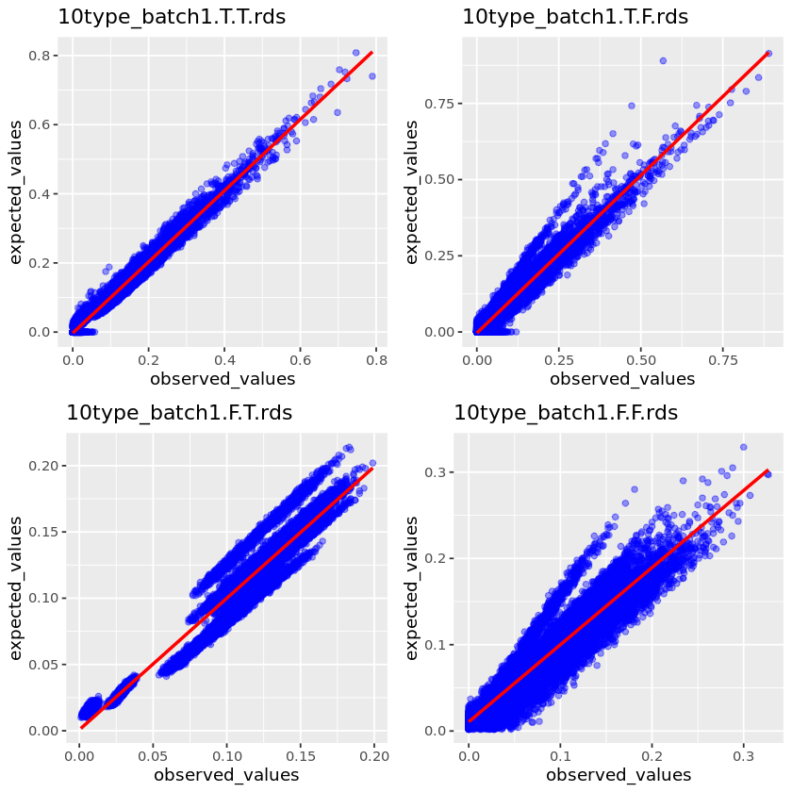
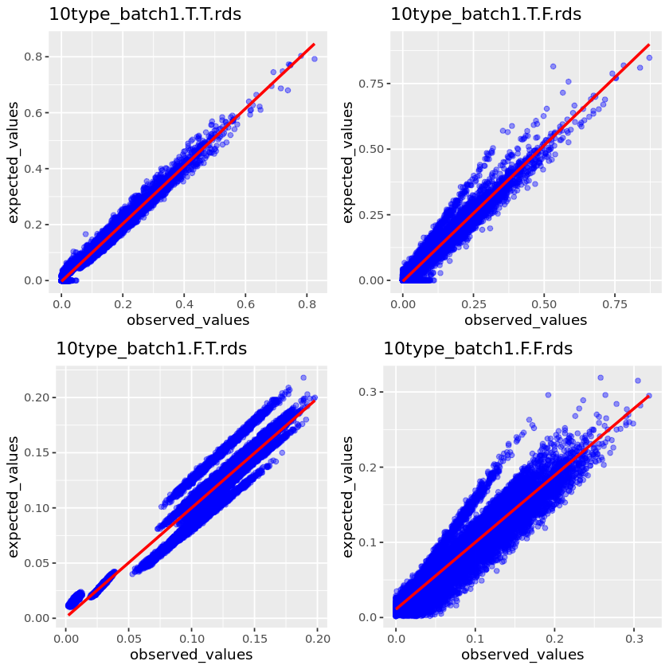
10 cell types
100 pseudobulk
10K pseudobulk
1M pseudobulk

Slide 33
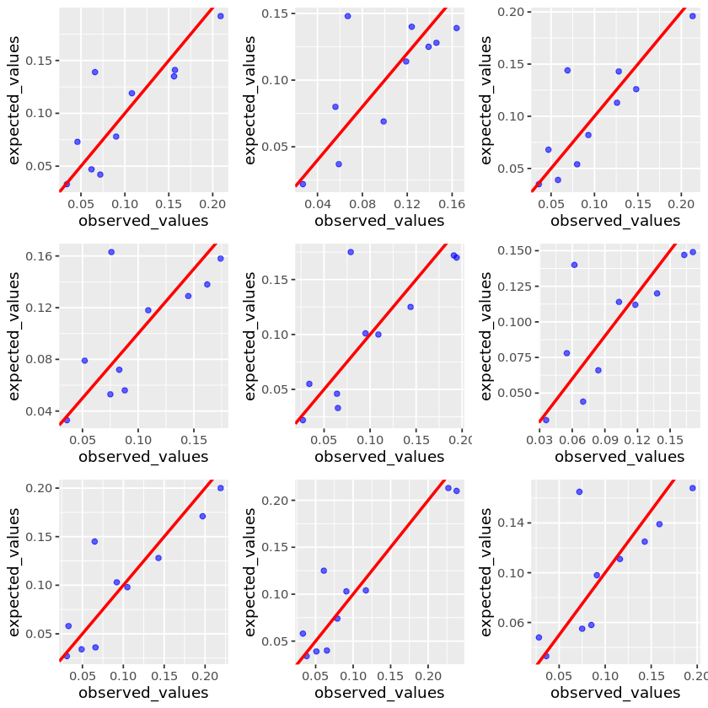
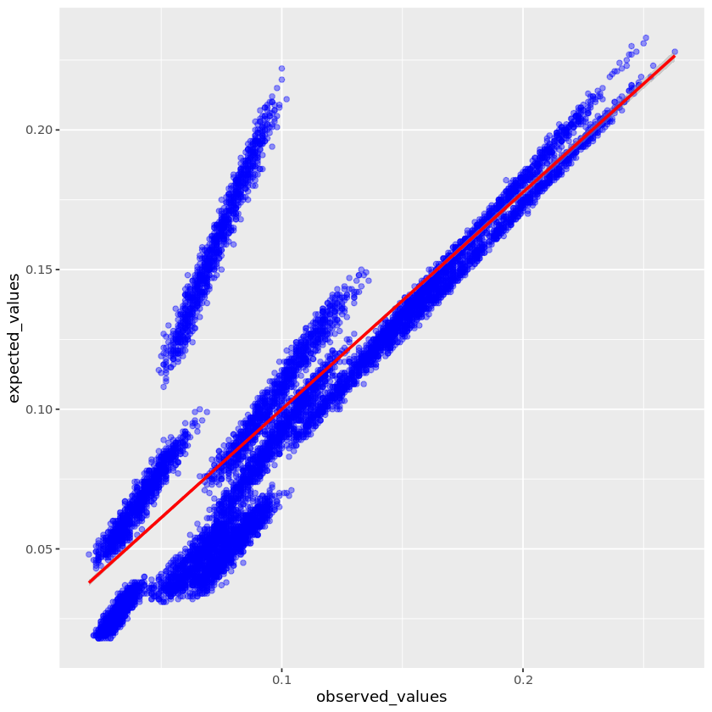
10 cell types, cross reference
10K pseudobulk
Notes:
Try another deconvolution method

Slide 34
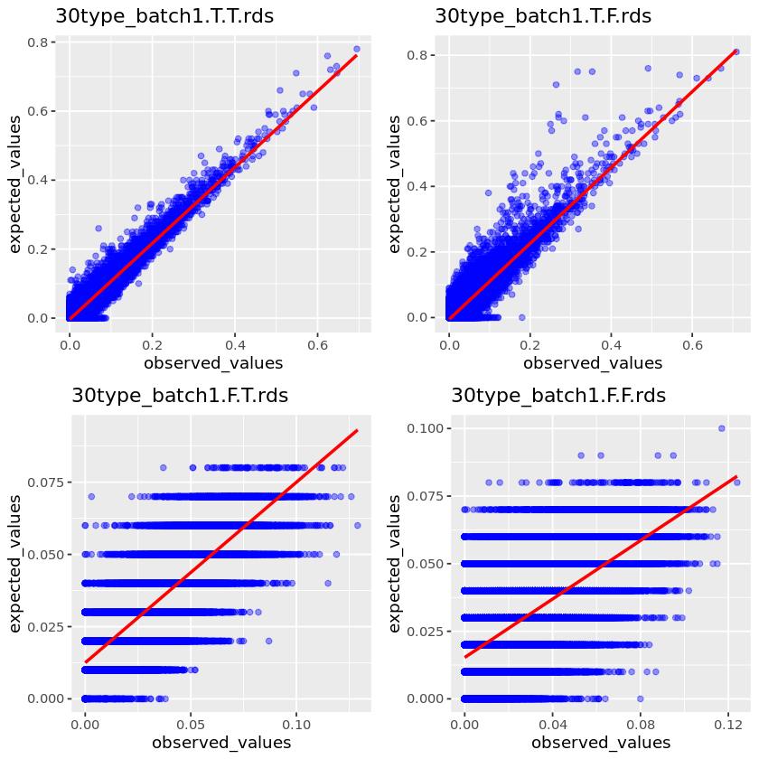
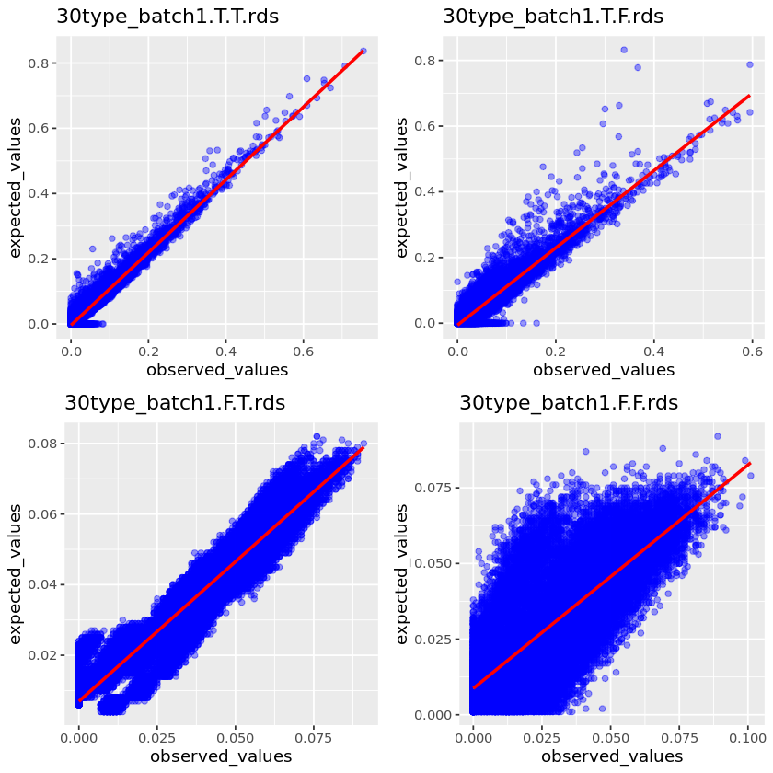
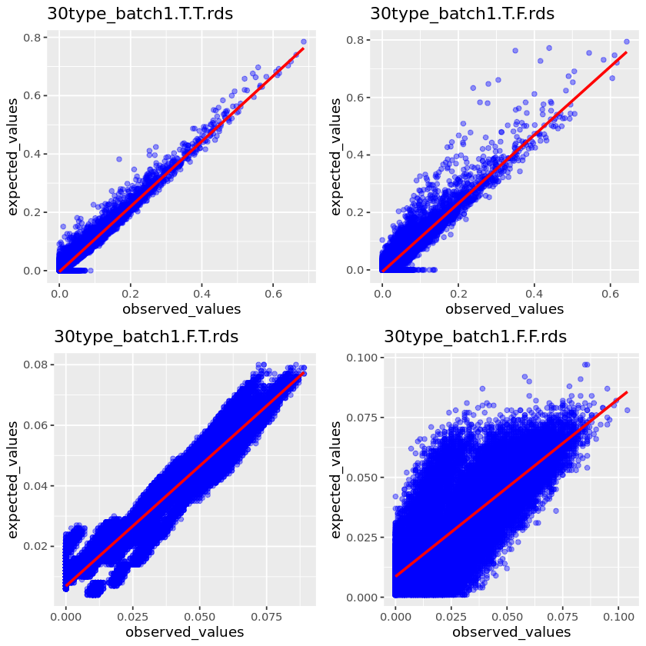
30 cell types
100 pseudobulk
10K pseudobulk
1M pseudobulk

Slide 35
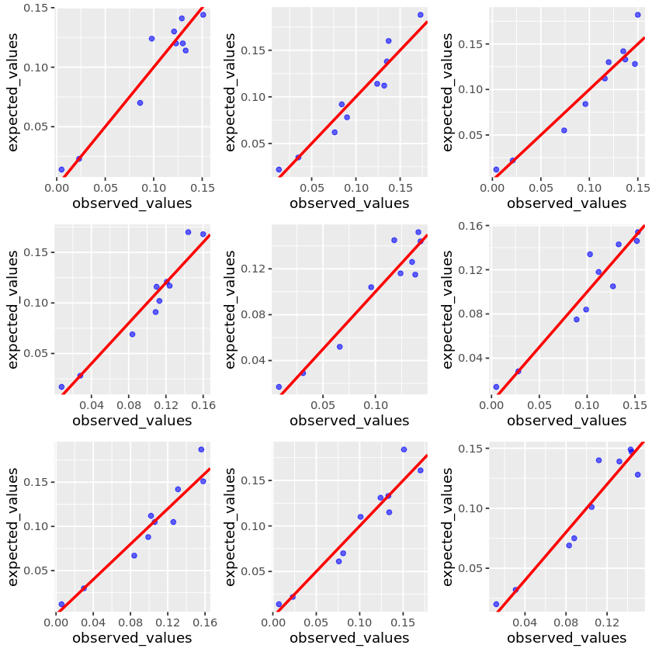
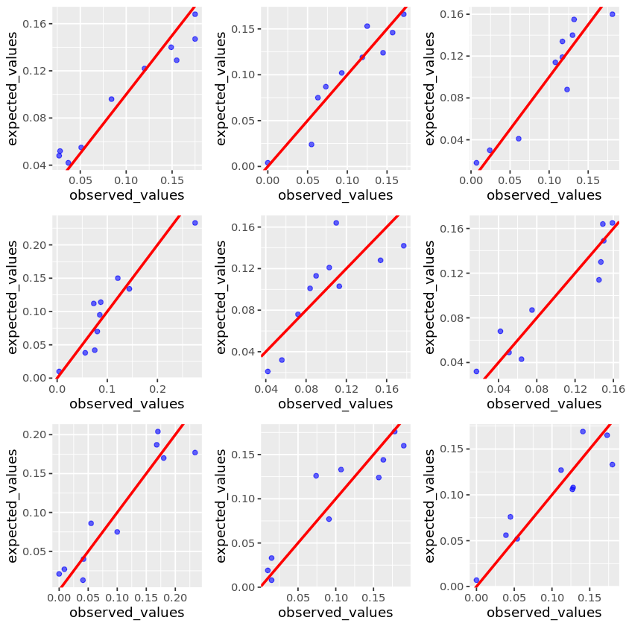
Prop sampling
10 cell types
random sampling

Slide 36
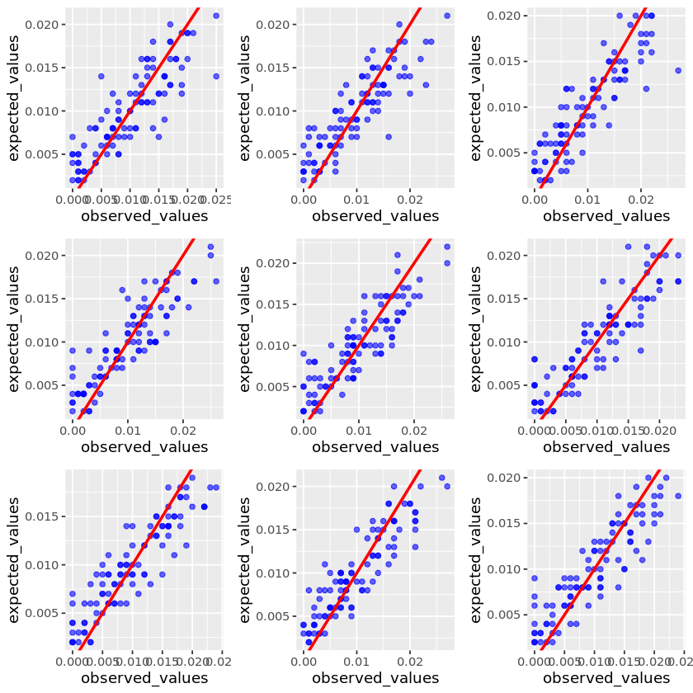
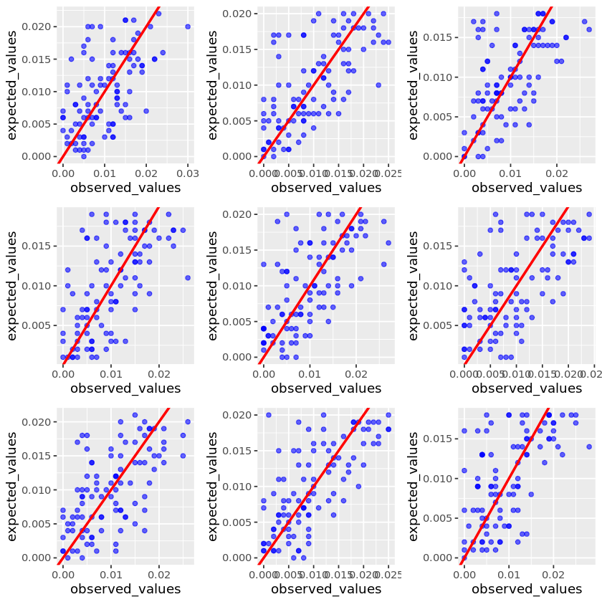
Prop sampling
100 cell types
random sampling

Slide 37
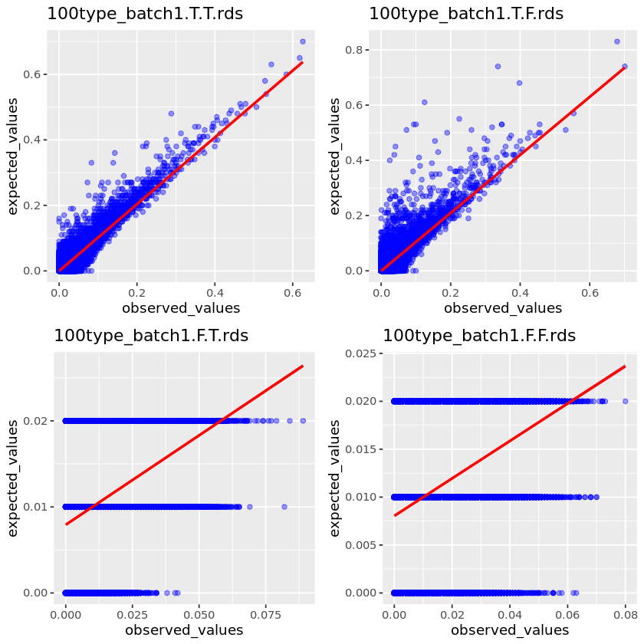
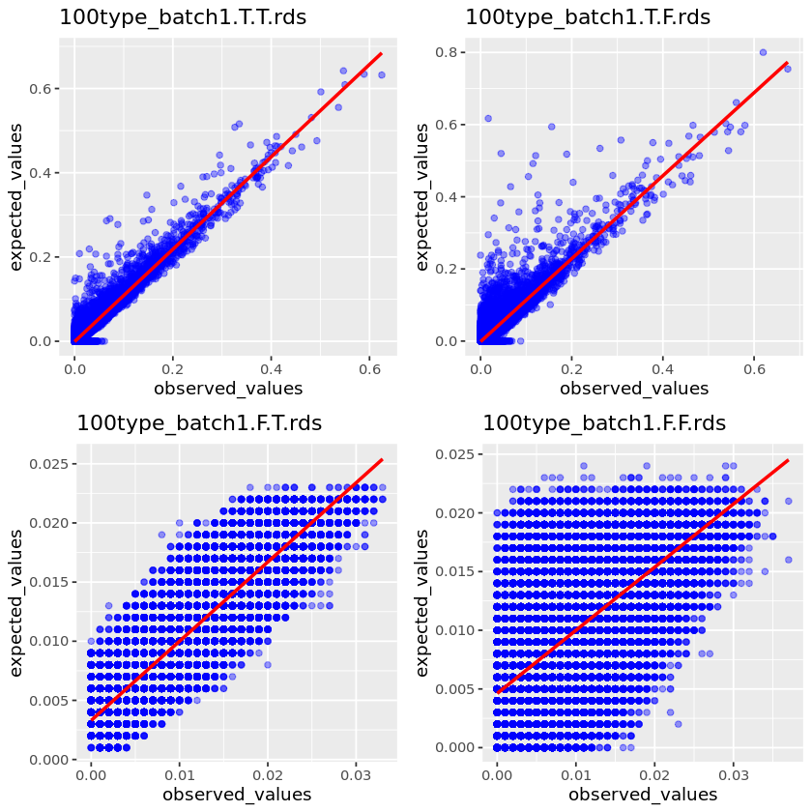

100 cell types
100 pseudobulk
10K pseudobulk
1M pseudobulk

Slide 38






Experimental design

Slide 39



Normalization
Pseudobulk
#CT the same as in reference/random 2-N
#cell proportional to known data, with fluctuation/random sampling
Generate 1K pseudobulk
Each pseudobulk includes TT cells
Transformation
Deconvolution

Slide 40
A large-scale benchmarking of cell type deconvolution methods
Chichau Miao, Anna Vathrakokili Pournara, Irene Papatheodorou

Slide 41
Experimental design
aim | Bulk | Reference
1: decide the parameters | pseudobulk made from reference | scRNA-seq
2: realistic benchmarking | pseudobulk made from another reference (batch effect) | scRNA-seq
3: benchmarking & potential application | Bulk RNA-seq of the same tissue | scRNA-seq
4: benchmarking & potential application | Bulk RNA-seq of the same tissue | 2 scRNA-seq

Slide 42
CATD
Framework
`Framework.R`
dependencies
Data preprocessing
`benchmark.R`
CATD_script.R
Calculate Results
`result.R`
I/O
self-reference
cross-reference
Bulk-reference
Bulk-2references
Marker genes
Convert from python to R
`format.R`
Normalization
Transformation
Python scripts
To run jobs
Deconvolution
`deconvolution.R`

Slide 43


Slide 44
Experiments in self-reference
Normalize first or Transform first?
Random sample cell types or proportional sampling?
Sample cell types or not?
How many cells to sample?
Normalization methods comparison (use log or none transformation).
Transformation methods comparison (use to top normalization methods)

Slide 45

Exp1: Normalize first or Transform first?

Slide 46

Exp2: Random sample cell types or proportional sampling?
Column/TMM + log1p

Slide 47

Column/TMM + none

Slide 48

Exp3: Sample cell types or not?
Column/TMM + log1p

Slide 49

Column/TMM + none

Slide 50

Exp4: 100 cells vs. 10K cells.
Column/TMM + log1p

Slide 51

Column/TMM + none

Slide 52

Exp5: Normalization methods

Slide 53


Slide 54


Slide 55


Slide 56


Slide 57


log
linear
Fardeep
Music

